Slide 1
Writing Class in Java
Session 3

Slide 2
Contents
Class and object
Writing class
Access specifier
Accessor and mutator methods
Constructor
Concept of ‘this’ reference
Static member and static method
Package

Slide 3
Class
Class can be defined as
  It is User Defined Data type (UDT)
  Template for creating like objects.
  Collection of data members and member functions.
Object – Any real life entity which has well defined structure and behavior.

Slide 4
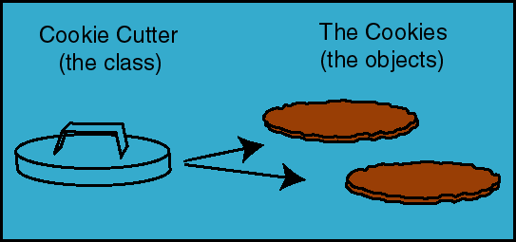
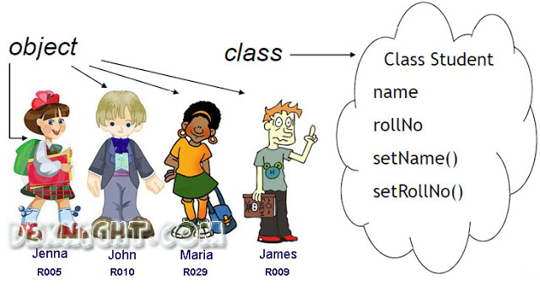
Class and object

Slide 5
Abstraction
Process of identifying key aspects of an entity and ignoring the rest.
Types
  Data Abstraction
    empId
    empName
    basicSalary
  Behavioral Abstraction
    displayData
    calculateSalary

Slide 6
Encapsulation
Process of hiding the data of object from outside world.
Interaction with data will be done only with the help of interface / behavior / method

Slide 7
Defining class
Syntax
class <class name>
{
<access specifier> <datatype> <member>;
<access specifier> <datatype> <member>;
<access specifier> <datatype> <member>;
<access> <return type> <Method name>(<parameters>)
{
Statement(s);
}
}

Slide 8
Class
class MyDate
{
private int day;
private int month;
private int year;
public void displayDate()
{
Sysout(“Date is: “ + day + “-” + month + ”-” + year);
}
}

Slide 9
Access specifier
Specifies accessibility of a member of class.
Java supports 4 access specifiers.
  public – accessible outside the class only with the help of object of class.
  default – it is the default access specifier. It is like a public but it is not accessible outside the package.
  private – Not accessible outside of class
  protected – Accessible in derived class

Slide 10
Object
Object is an instance of class.
public static void main(String[] args) {
MyDate d1 = new MyDate();
d1.displayDate();
}
Object of MyDate class
Data Type / Class

Slide 11
Accessor and Mutator methods.
Accessor method
public int getDay() {
return day;
}
public void setDay(int d) {
day = d;
}
public void displayDate()
{
System.out.println("Date is: " + day + "-" + month + "-" + year);
}
Mutator method
Facilitator method

Slide 12
Constructor
Constructor is a special member function of class.
It has same name as class name.
No return type (not even void)
Invoked implicitly when object is created.
Used to initialize data members of class.
Can be overloaded. (Class can have more than one constructor)

Slide 13
Constructor
Plain / Default / No parameter constructor
public MyDate() {
day = 1;
month = 1;
year = 2018;
}
public MyDate(int d, int m, int y) {
day = d;
month = m;
year = y;
}
Parameterized constructor

Slide 14
‘this’ reference
Every class method is having an implicit hidden parameter a ‘this’ reference.
‘this’ holds address of an object which is invoking the method.
Remove shadow of the instance field.
Used to access current object in the method.

Slide 15
Static Member
When any member of class needs to be common for all objects, such data members are declared as static.
Like interest rate for bank account, company for employee
Such members having single copy per class. (All objects will having the same copy)
Where instance members (non-static) having separate copy per object.

Slide 16
Static member
company
e1
empID
empName
e2
empID
empName
e3
empID
empName

Slide 17
Static method
Static methods are invoked by class name.
ClassName.method();
Reference ‘this’ is never passed to static method. (Because those are called by class name/ not called by an object)
Non static members (instance members) can’t be accessed in static methods. (As ‘this’ reference is not passed to static method)

Slide 18
public static void main()
Why main() is declared as static?
  main() is declares as static because it is invoked before instantiation (creating object) of class.
  If it is not declared as static then OS has to create object of class first and then it needs to be called.
  So main() is declared as static.

Slide 19


